Slide 1
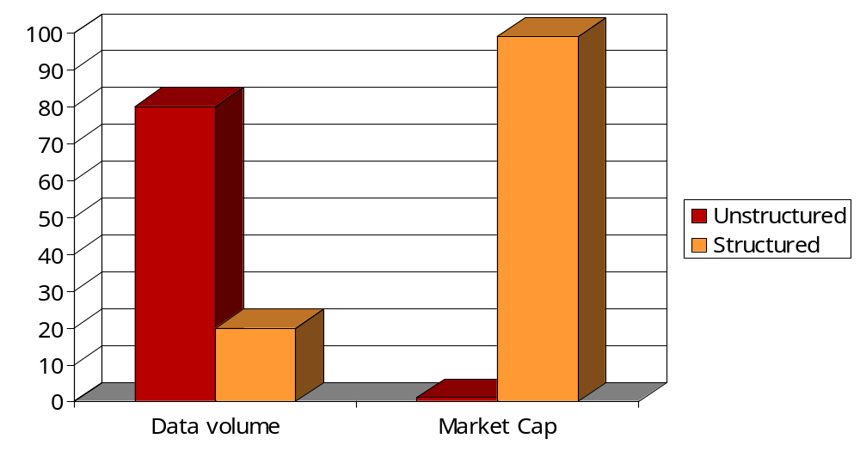
Relational envy
Extracting and exploiting structure
(in “unstructured” data) is valuable.

Slide 2
Theses
Search is neither a box nor an appliance – it’s a platform for applications
People don’t conduct searches for the fun of it
  They do so as part of a workflow
    Hiring a team – given a stack of XML resumes w/o DTDs
    Designing an assembly
    Planning a vacation
  Future applications – “retrospective” search more integrated into workflow

Slide 3
Theses
Opportunity: Content-driven workflow
  Service records flow in from auto dealerships
    Structured as well as unstructured (ignored) fields
  Find frequent co-occurences (e.g., Make = Ford AND Text contains rollover NEAR tire )
  Other applications in health-care, customer service …
Content analytics

Slide 4
Challenges
Diversity in amounts of structure available
DTD diversity
Structure extraction/normalization
Composition into applications
  People put up with junk – they’re fine if most of what they get is good
  Mission-critical applications are more stringent
    Would you warn of a suspected epidemic 4 times a day?

